Slide 1
Project 1: Sleep Study
Lydia Bartnick
Anna Collawn
Gil Fernandez
Jared Sletto

Slide 2
Overview
Exploring the different relationships within the dataset.
Is there a relationship between sleep duration, quality of sleep, and physical activity with different physiological responses?
Does age, gender, and profession play a role in the duration and quality of sleep?

Slide 3
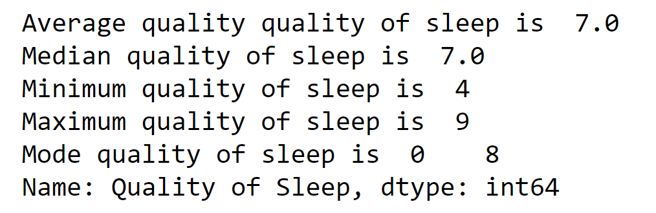
Quality of Sleep
Quality of sleep is the measurement of how well someone sleeps at night. The average adult needs 7 or more hours of restful and restorative sleep.

Slide 4
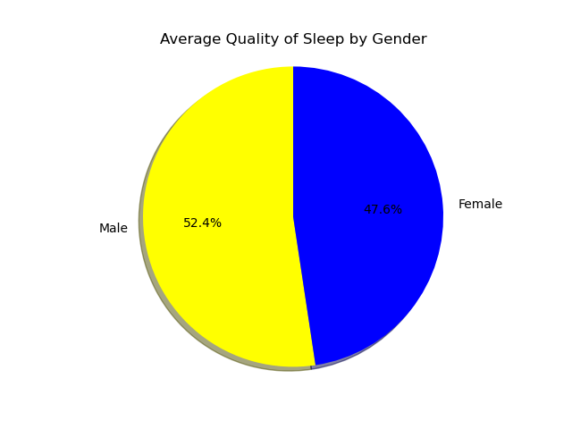
Which Gender Gets the Better Quality of Sleep?
In this dataset, 185 males and 189 females were analyzed. On average, the men from the dataset get a more restful and restorative sleep. Men, on average, received 8 hours of quality sleep, while women received 7 hours.

Slide 5
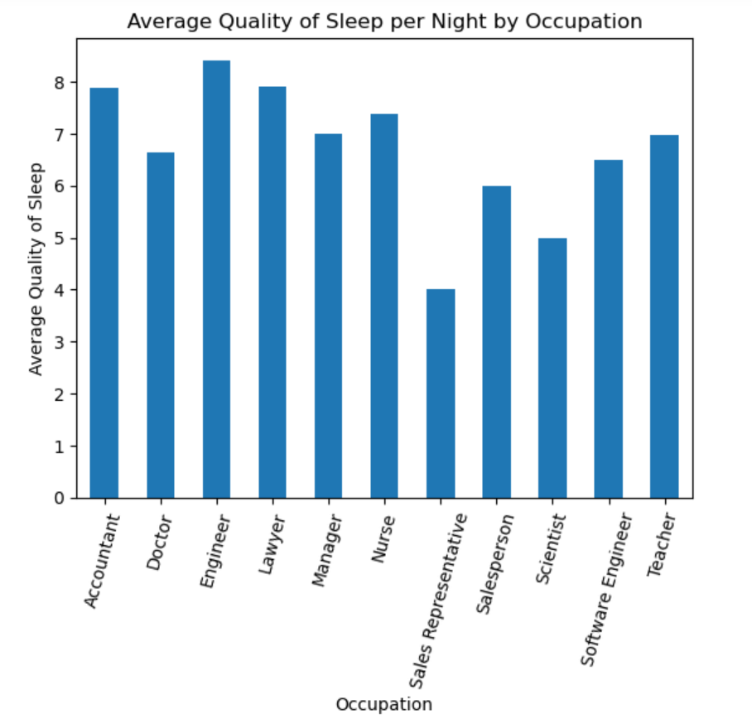
Which Profession Gets Better Quality of Sleep?
Eleven professions were analyzed from different industries. Sales Representatives, Scientists, and Doctors receive below the average quality of sleep, while Engineers, Lawyers, and Accounts receive on average or higher quality of sleep.

